Slide 1
Brain Tumor
Detection
Presented By
Ayush Paul(213223-21-0012)
&
Antareep Das(213223-21-0042)
Using Artificial Intelligence

Slide 2
Overview
MRI devices are vital for diagnosing critical conditions and serve as big data for Artificial Intelligence (AI).
This big data enhances performance in image classification, a subset of AI.
Our study focuses on detecting brain tumors from MRI images using deep learning, specifically Convolutional Neural Networks (CNN).
Tumors are uncontrolled cell growths that deplete nutrients from healthy cells, leading to brain failure.
Currently, doctors manually analyze MRI images to locate tumors, which is time-consuming and often inaccurate.
Using CNNs can improve early diagnosis and treatment by accurately predicting the presence of tumors in MRI images.
If a tumor is detected, the model returns "Yes" otherwise, it returns "No".
AI uses Big Data, Machine Learning, and Deep Learning to improve MRI scan analysis.
AI detects and classifies tumors by size, location, and aggressiveness.
The brain can develop primary (benign) and secondary (malignant) tumors.
Primary tumors, like gliomas, are less aggressive but can still pressure the brain.
Secondary tumors are more aggressive and spread from other cancers.
MRI, invented in 1969, provides superior image quality for brain tumor detection.

Slide 3
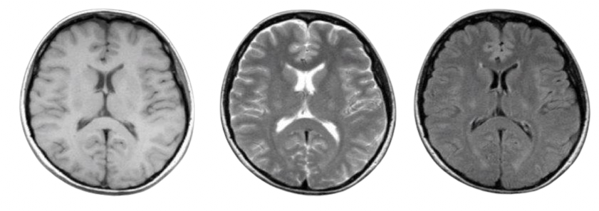
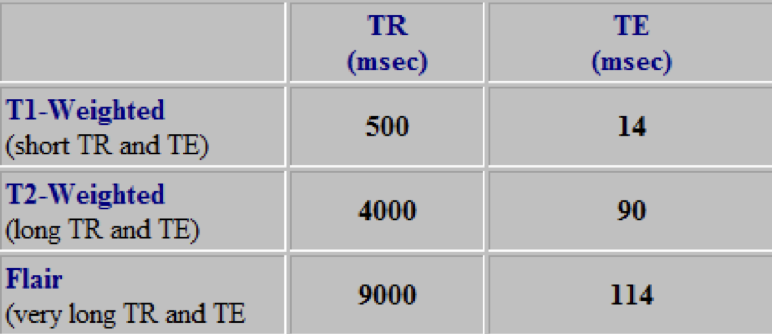
TYPES OF MRI
T1-Weighted
T2-Weighted
FLAIR
Table of TR and TE time

Slide 4
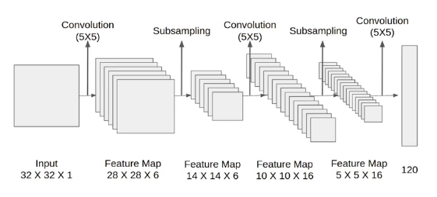
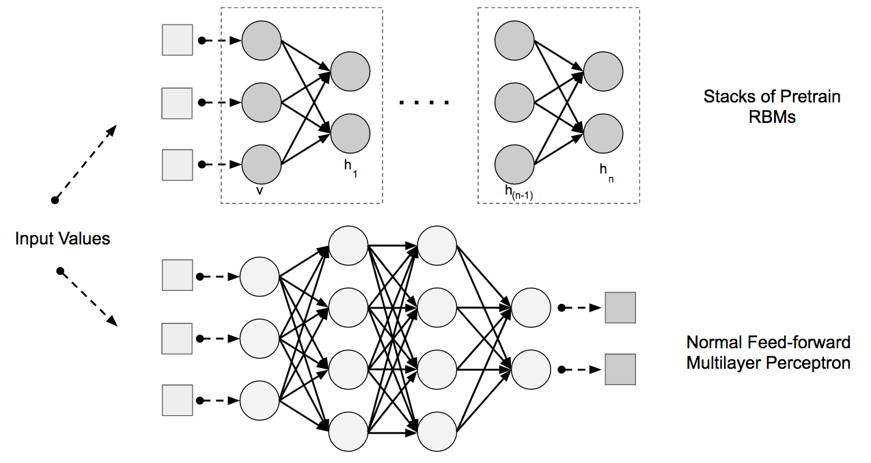
CNN ARCHITECTURES
Lenet Model architecture
01
Gather a dataset of brain MRI images that includes both images with brain tumors (positive samples) and images without tumors (negative samples). It's essential to have a diverse and representative dataset to train a robust model.
02
Model Architecture
Design a CNN architecture suitable for the task of brain tumor detection. This architecture typically consists of multiple convolutional layers followed by pooling layers for feature extraction, followed by one or more fully connected layers for classification.

Slide 5
Deep learning is a subset of machine learning that trains artificial neural networks to learn patterns directly from data.
It does not require manual feature engineering, unlike traditional machine learning.
Deep learning autonomously extracts hierarchical features, creating powerful and accurate models.
This study employs a Convolutional Neural Network (CNN) architecture.
Convolutional neural networks (CNNs) are a major breakthrough in deep learning and computer vision, designed to extract meaningful features from complex visual data.
The CNN architecture, with convolutional layers, pooling layers, and fully connected layers, mimics the human visual system pattern recognition.
CNNs' inherent structure and capability have led to remarkable advancements in diverse visual domains.
Deep Learning
Cnn

Slide 6
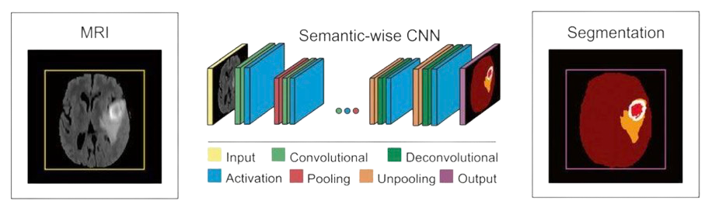
WORKING OF CNN MODEL
Layers of CNN model:
★ Convolution 2D
★ MAXPooling2D
★ Dropout
★ Flatten
★ Dense
★ Activation

Slide 7
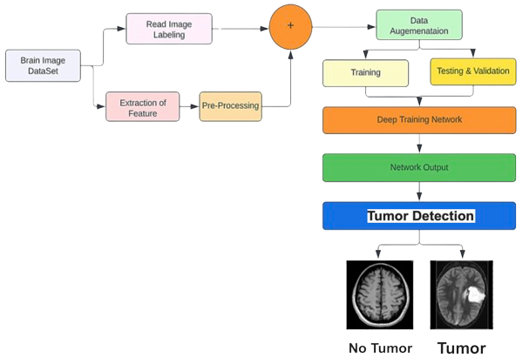
PROPOSED NEURAL NETWORK ARCHITECTURE
The proposed system has mainly five modules:
Data Source
Preprocessing
Data Split the data
Build CNN model train Deep Neural network for epochs
Detection

Slide 8
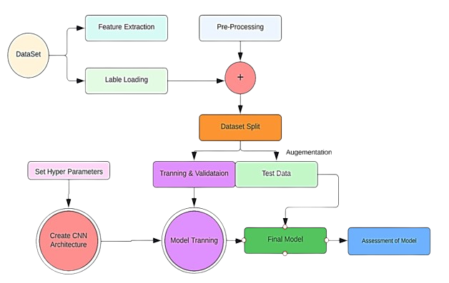
FLOW DIAGRAM
Flow diagram of proposed methodology for tumor detection

Slide 9
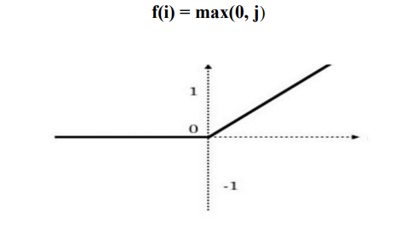
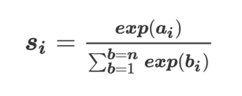
Activation Function
The Rectified Linear Unit (ReLU) is a popular activation function in deep learning.
ReLU is computationally efficient, avoiding expensive calculations like those in sigmoid or tanh functions, speeding up training.
ReLU helps prevent the vanishing gradient problem, maintaining significant gradients for positive inputs and improving deep network training.
The SoftMax layer is a key activation function for classification tasks in neural networks.
Transforms raw scores (logits) into probabilities between 0 and 1, ensuring they sum to 1.
This allows for a probabilistic interpretation of outputs, useful for multi-class classification.
SoftMax helps in making informed predictions by providing class probabilities.
Despite these issues, SoftMax is widely used for its effectiveness in classification tasks.

Slide 10
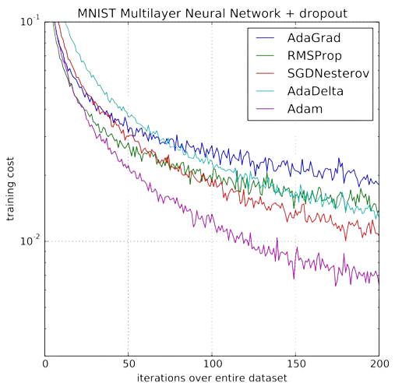
ADAM
Adaptive moment estimation
It adds nonlinearity to the network
These activation functions are used to learn and find the accuracy of the continuous and complex relationships between network variables

Slide 11
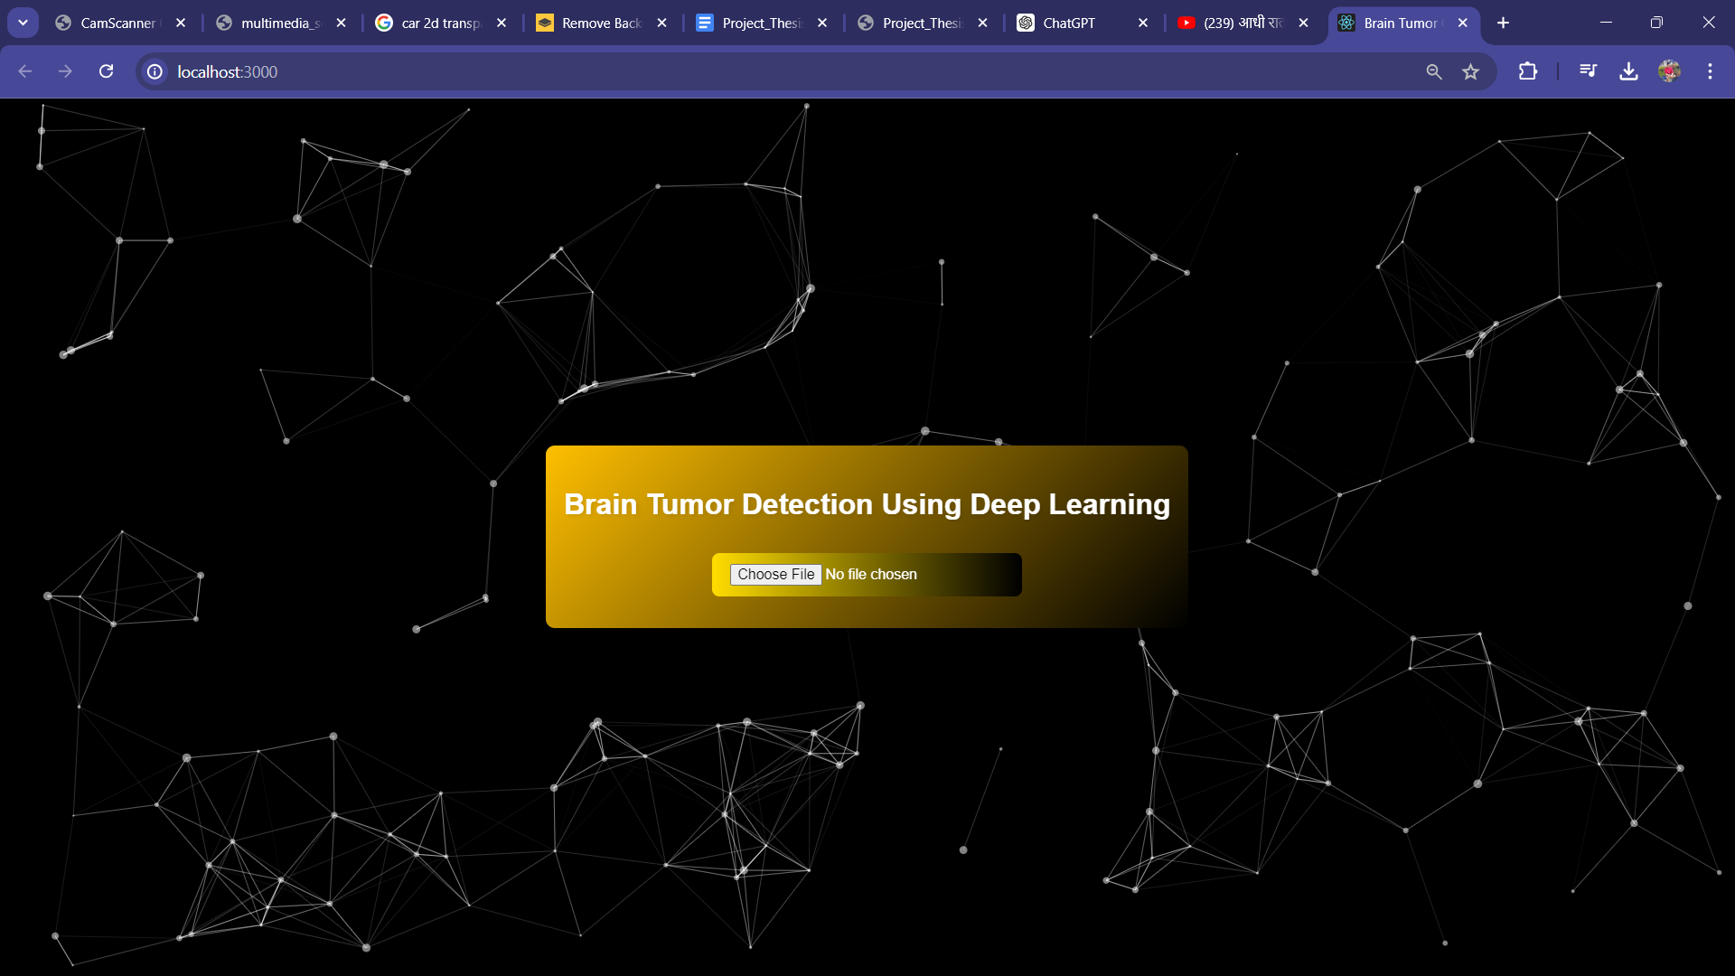
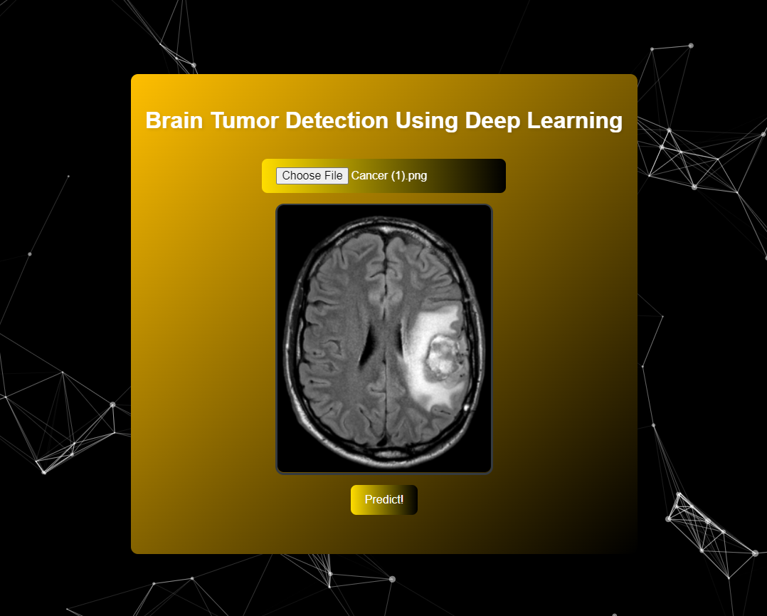
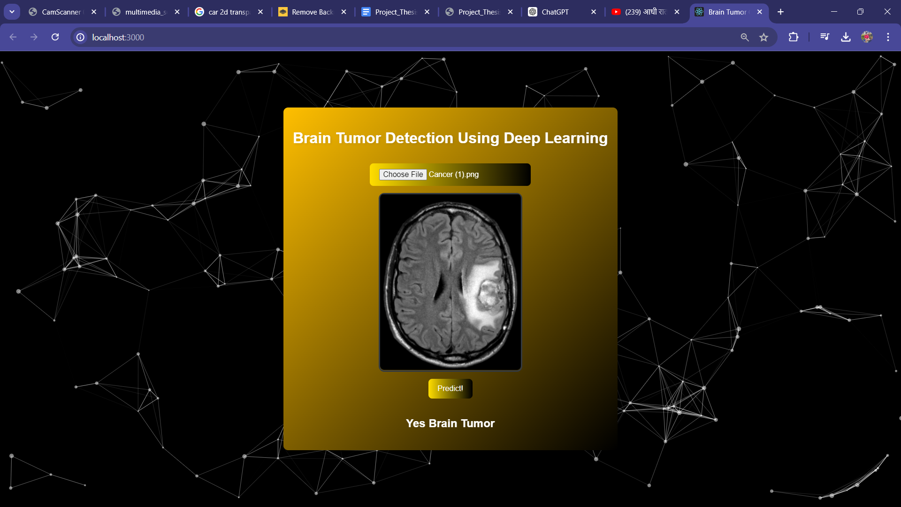
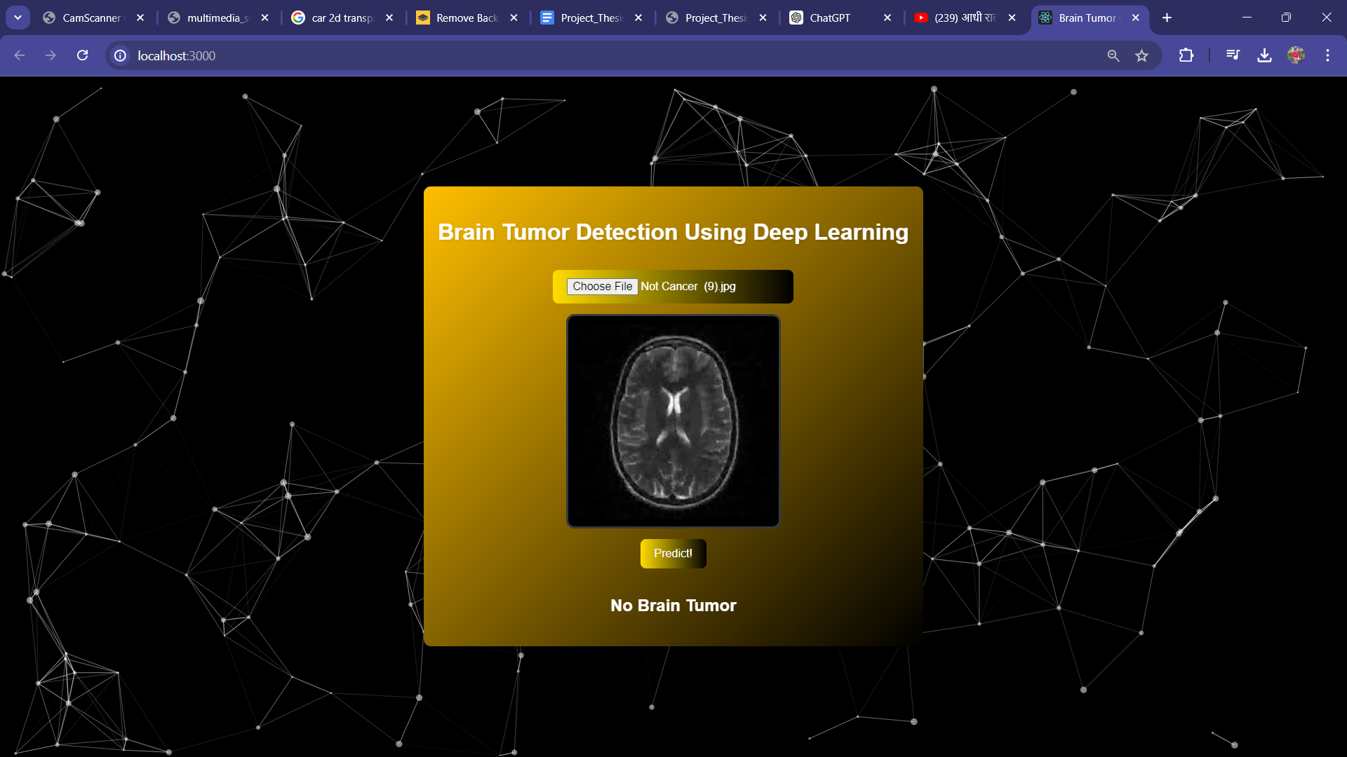
Implementation
Uploaded Axial MRI
Landing Page
Tumor Detection Positive
Tumor Detection Negative

Slide 12
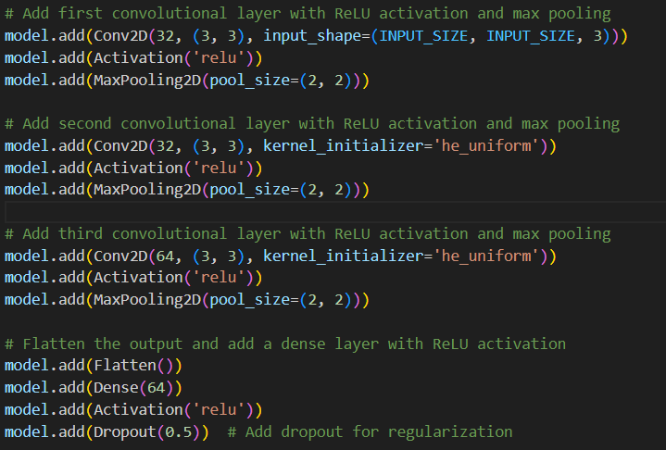
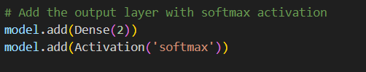
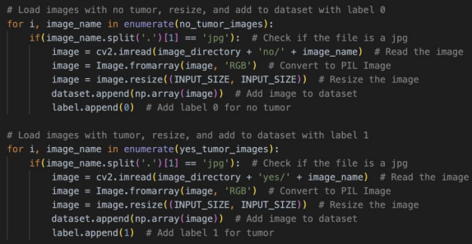

Implementation
ReLU Activation
ReLU Activation and Max Pooling
SoftMax Activation
Split of image data
Label of the image

Slide 13
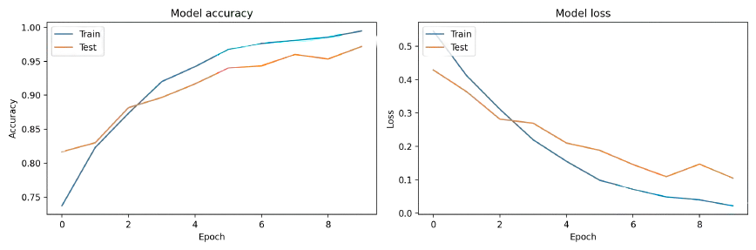
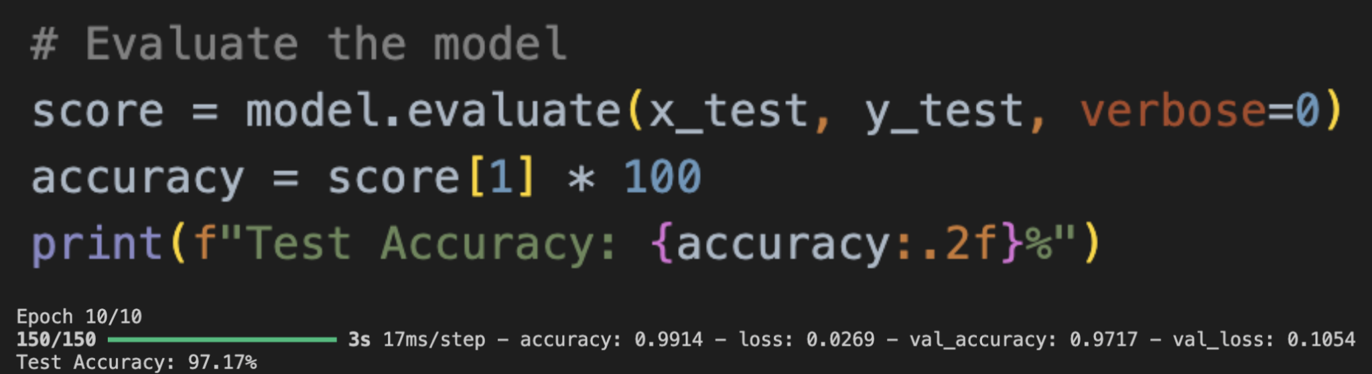
ACCURACY
CNN testing accuracy score 97.17%

Slide 14
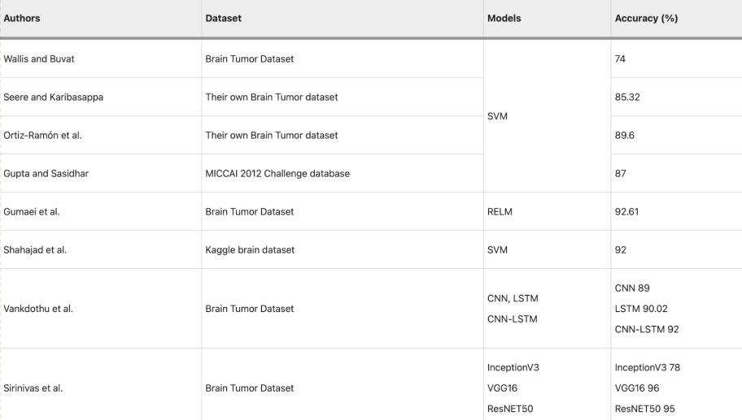
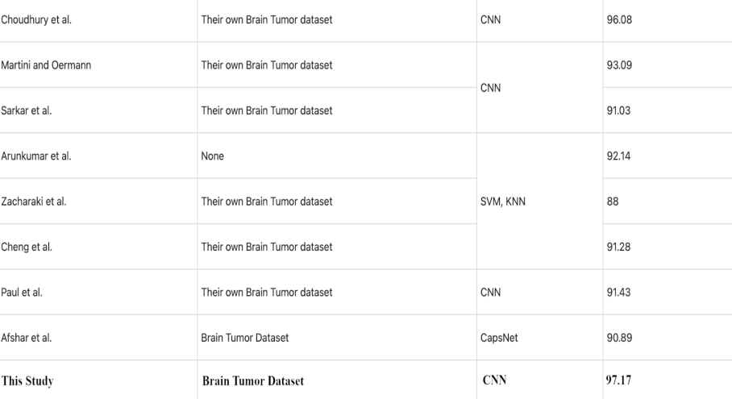
Comparisons with previous studies on brain tumor

Slide 15
DISCUSSION
Limitation:
Doesn’t always provides the most accurate result when MR images are presented from different angles.
Performs best only if axial brain MRI images are presented.
Future Scope:
AI in healthcare enables faster and more accurate diagnoses and treatments.
It supports doctors, addressing ethical, security, and privacy issues and improves patient quality of life.
This study highlights AI's importance, recommending CNN methods for image processing, with future research focusing on real-time CT and MR image diagnoses.
Conclusion:
Researchers have developed a CNN-based Brain Tumor Detection Model for accurate and efficient brain cancer diagnosis, targeting cancers such as carcinoma, glioma, meningioma, and pituitary tumors.
This methodology can extend to other cancers like leukemia, lymphoma, melanoma, sarcoma, and breast cancer. Continuous AI and DL advancements can refine these models, integrating multimodal data to enhance diagnostic capabilities and improve patient outcomes.

Slide 16


THANK YOU
ANTAREEP DAS
AYUSH PAUL

